Slide 1
Enabling Distributed Architectures with a Service Bus
S. Kyle Korndoerfer

Slide 2
Existing/Common Architectures
Main application does everything!
Sends email notifications
Submits data to web services (internal or external)
Generates/Writes files to disk
etc.
What happens when any of these steps fail?
What if it is responding very slowly?
What about system resources?

Slide 3
3rd-Party/External Svc
App / Web Site
Mail Server
Async Operations
Logging
Tracing

Slide 4
Distributed Architecture
Break down your application into ‘services’ that each have a singular focus (the Single Responsibility Principle of SOLID design)
Your User Interface layer should (primarily) be about serving and collecting data from your users.
Email service for notifying users when things are ready (think order confirmation emails from Amazon)
Receipt Service for generating customer receipt PDF’s
Submitting data to external sources (like CRM’s, Data Warehouses, etc.)

Slide 5
App / Web Site
Middleware
Messaging
3rd-Party/External Svc
Mobile App / Service
Mail Server
Services
Async Operations
Logging
Tracing

Slide 6
Service Bus as the Enabler
A Service Bus is the ‘post office’ for services, holding and coordinating the messages that need to sent to the services.
Can be live/real-time (Relay)
Great for applications/services that sit behind a firewall but need an open communication channel that allows messages to be sent/received in real-time.
Both ends of the Relay service need to be active at the same time
Can be delayed (Brokered)
Great for services that are asynchronous messages or when connectivity cannot be guaranteed (mobile).
Either end can be taken offline because of upgrades, loss of connectivity, or (gulp) crashes

Slide 7
Brokered Messaging: Queues
Simplest to work with
Messages are added to a queue and processed in the order they are received
Usually one queue for each service or message type, but can be mixed
If mixing message types, they should be destined for the same service
Meant for Single Delivery
Processed by only one or more competing services

Slide 8
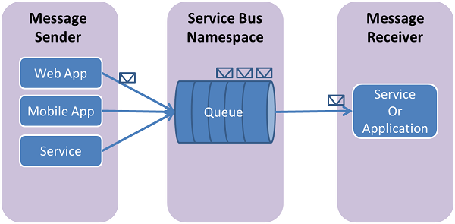

Slide 9
Brokered Messaging: Topics
Still functions like a Queue, but works in a Pub/Sub manner for multi-cast messaging
Allows more than one service to receive the same message on their own schedule.
A Topic is created (either manually or by a Publisher)
A Publisher sends a message to the Topic where it is queued
Messages/Topics can have a delivery timeout to avoid buildup of messages that never get delivered
Subscribers register to receive messages from the Topic

Slide 10
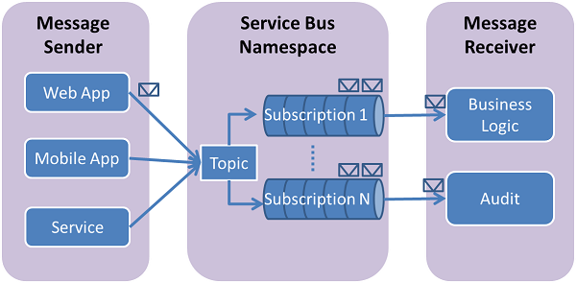

Slide 11
Message Processing
Using the “Post Office” metaphor…
Queues/Topics are the Post Office Boxes
Holds the messages until they expire, retry counts, max queue size, etc.
Message Properties are the text on the outside of the envelope
Useful for topic subscriptions to only subscribe to certain messages; unique message id
Messages are the contents inside an envelope
Body content; usually need to know the message format to process them

Slide 12
Message Retrieval Modes
ReceiveAndDelete
Reads the message from the queue/topic and then immediately deletes it
No durability; if the service crashes then the message is lost unless it is persisted locally
PeekLock
Durable, 2-stage retrieval process
Message is locked when retrieved to prevent other services from retrieving it
Must call .Complete() on the message before lock expires
If service crashes, then the lock will expire allowing others to process
If you receive a bad message, call .DeadLetter() on it to prevent reprocessing
Notes:
Can also call .Abandon(), but that makes the message immediately available for processing which isn’t good if the service is dependent on system that might be down.

Slide 13
Demos

